Slide 1

CORONA VIRUS ANALYSIS
Presented By - ARSHAD PARVEZ.G

Slide 2


Slide 3
DATASET
Description of each column in the dataset:
Province: Geographic subdivision within a country/region.
Country/Region: Geographic entity where data is recorded.
Latitude: North-south position on Earth's surface.
Longitude: East-west position on Earth's surface.
Date_s: Recorded date of CORONA VIRUS data.
Confirmed: Number of diagnosed CORONA VIRUS cases.
Deaths: Number of CORONA VIRUS-related deaths.
Recovered: Number of recovered CORONA VIRUS cases.

Slide 4
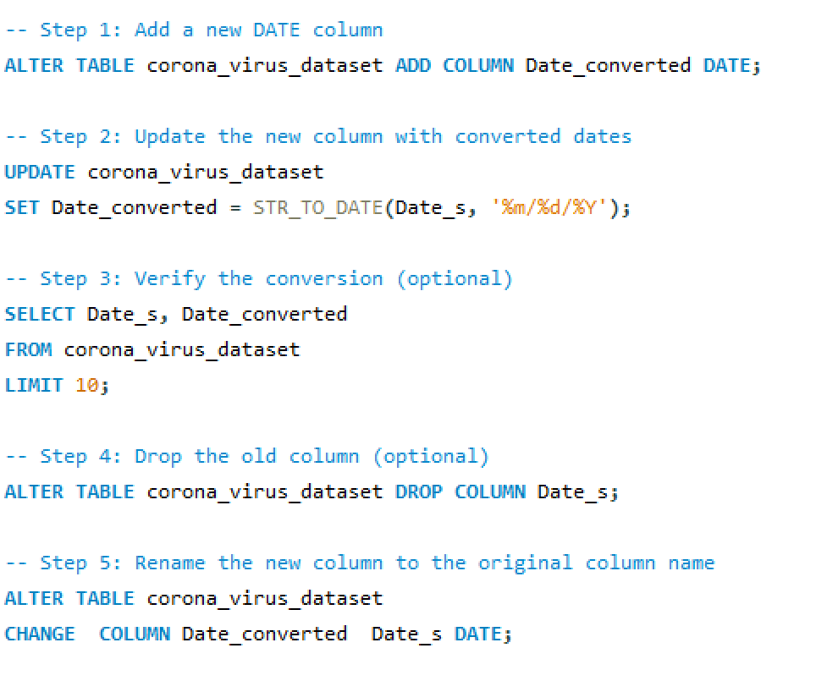
SCHEMA MODIFICATION

Slide 5
DATA ANALYSIS

Slide 6
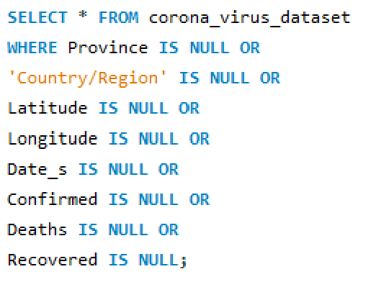
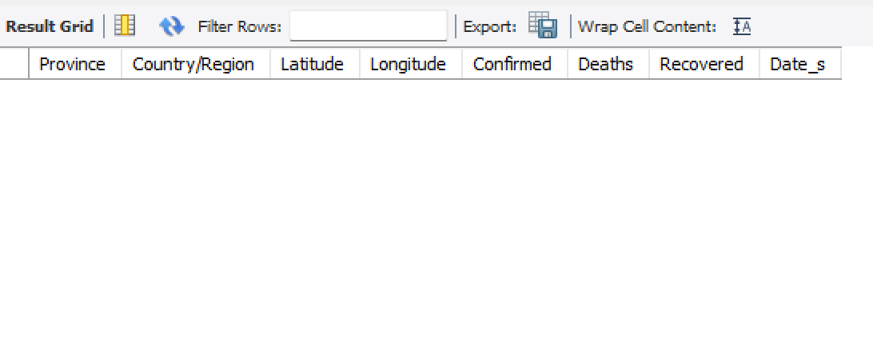
Q1. Write a code to check NULL values

Slide 7
Q2. If NULL values are present, update them with zeros for all columns.
There are no null values, so there is no need to update them with zeros.

Slide 8
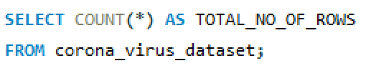
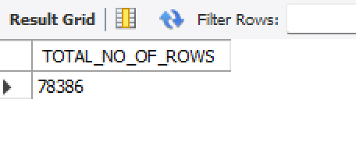
Q3. check total number of rows

Slide 9
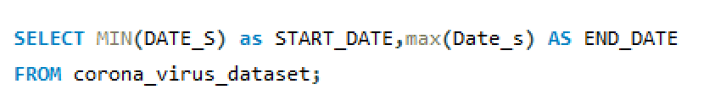
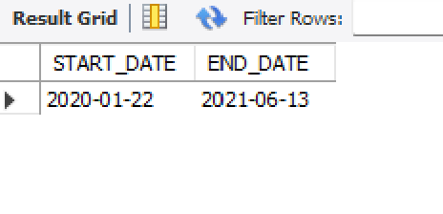
Q4. Check what is start_date and end_date

Slide 10
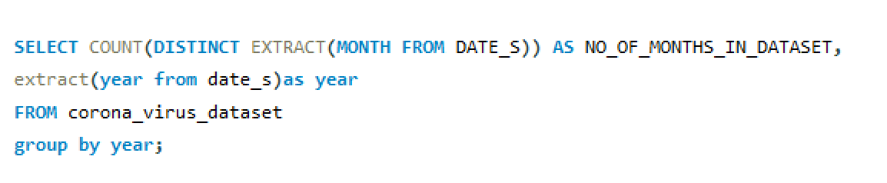
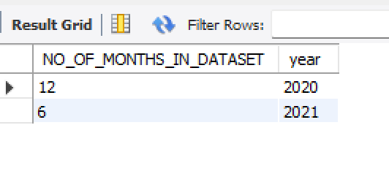
Q5. Number of months present in dataset

Slide 11
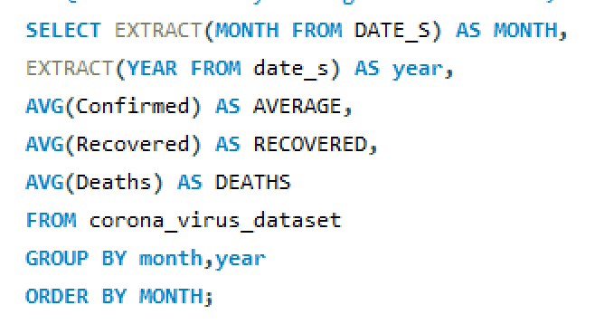
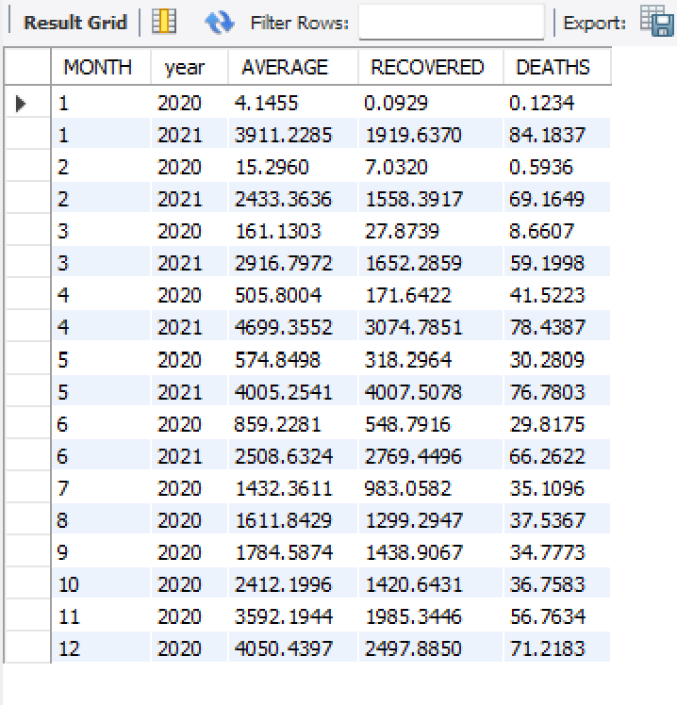
Q6. Find the monthly average for confirmed, deaths, recovered

Slide 12
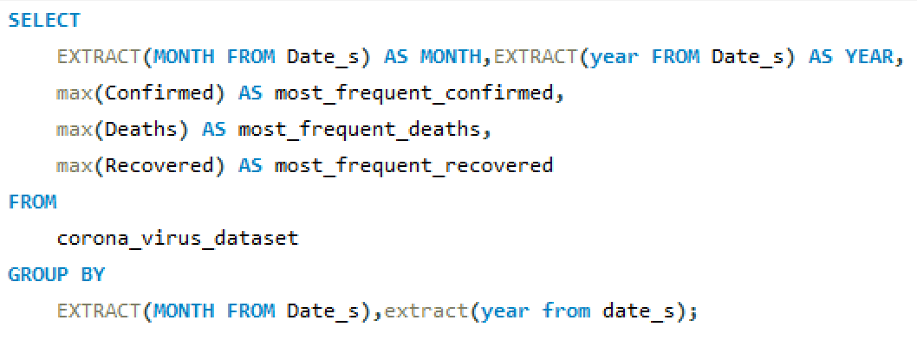
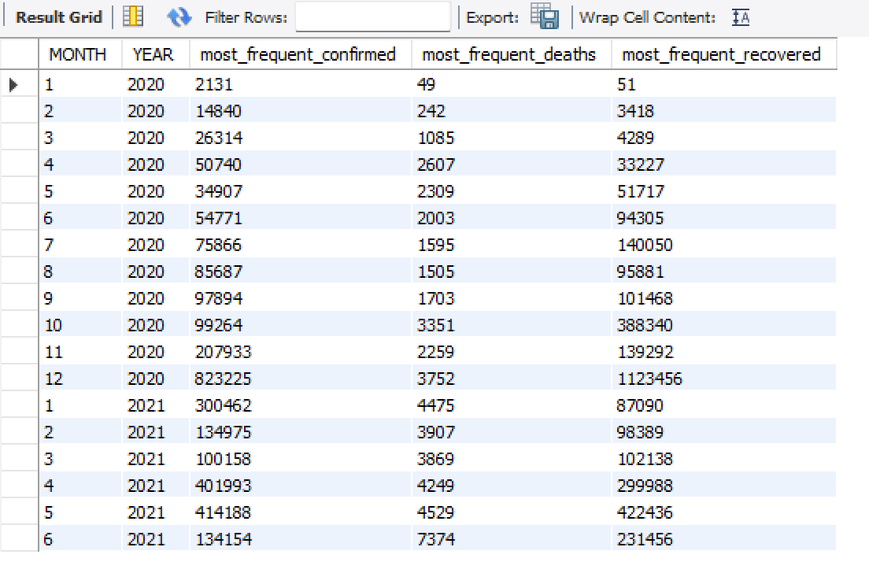
Q7. Find most frequent value for confirmed, deaths, recovered each month

Slide 13
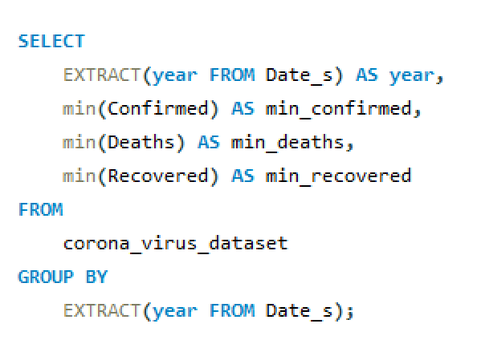
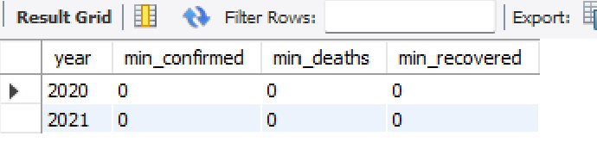
Q8. Find minimum values for confirmed, deaths, recovered per year

Slide 14
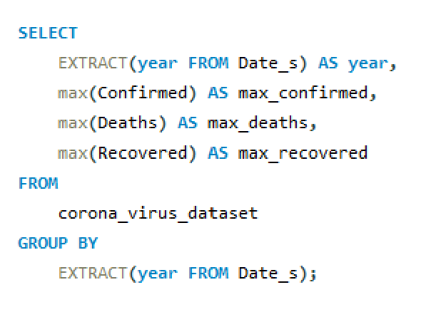
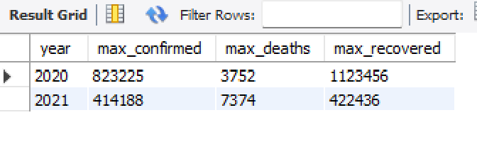
Q9. Find maximum values of confirmed, deaths, recovered per year

Slide 15
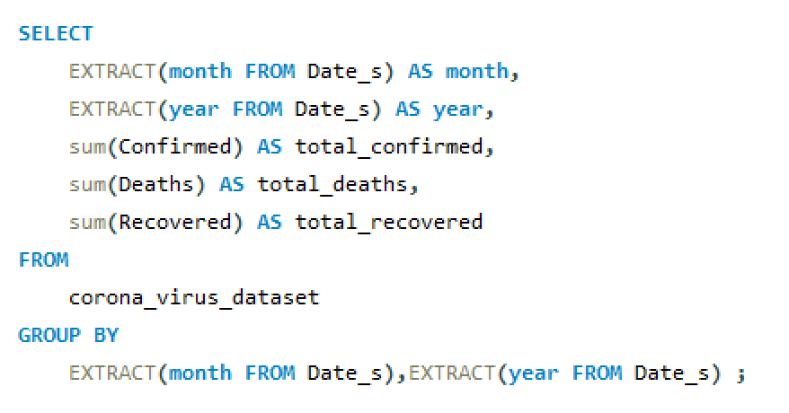
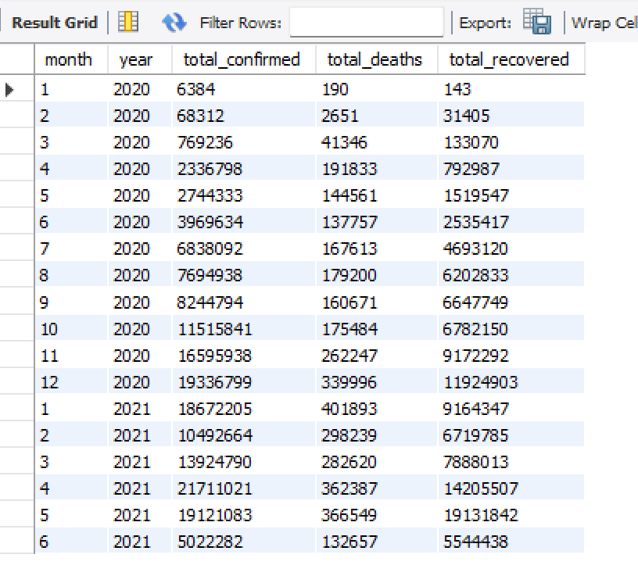
Q10. The total number of cases of confirmed, deaths, recovered each month

Slide 16
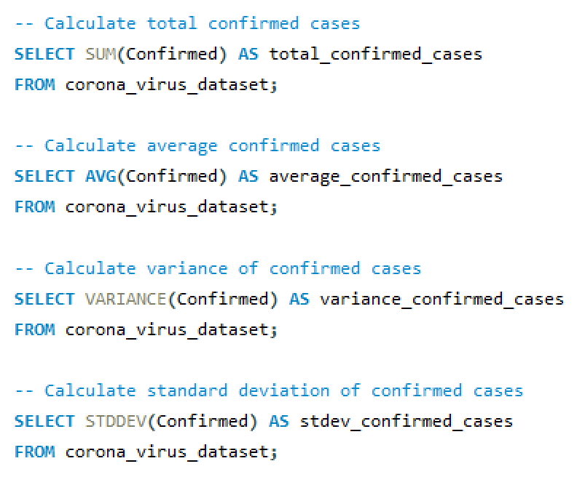
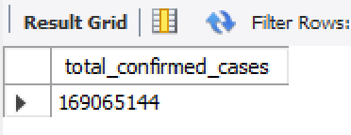
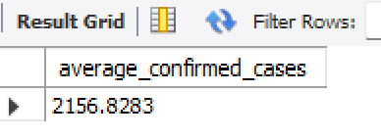
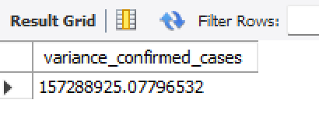
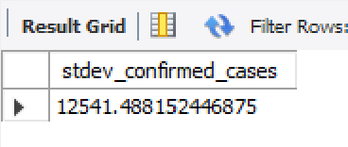
Q11. Check how corona virus spread out with respect to confirmed case

Slide 17
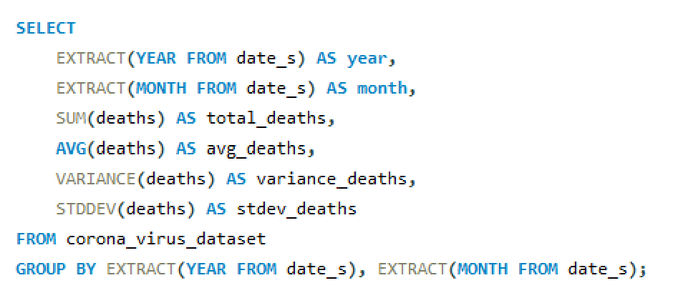
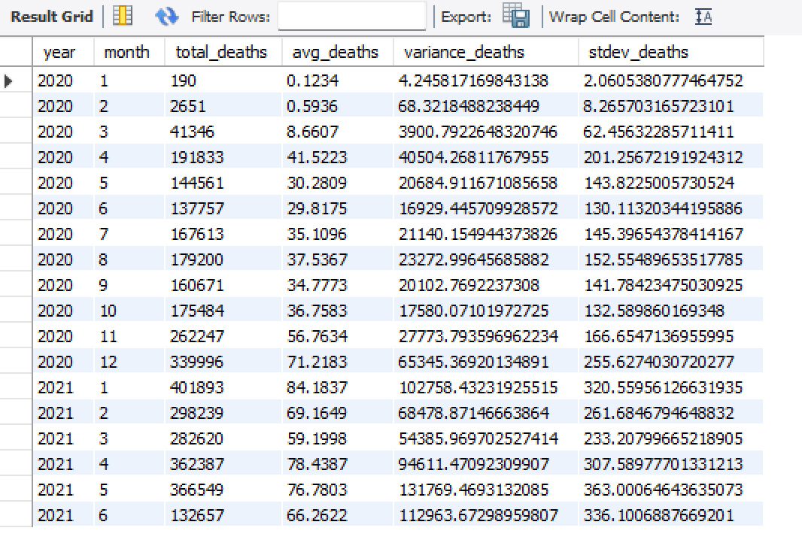
Q12. Check how coronavirus spread out with respect to death cases per month

Slide 18
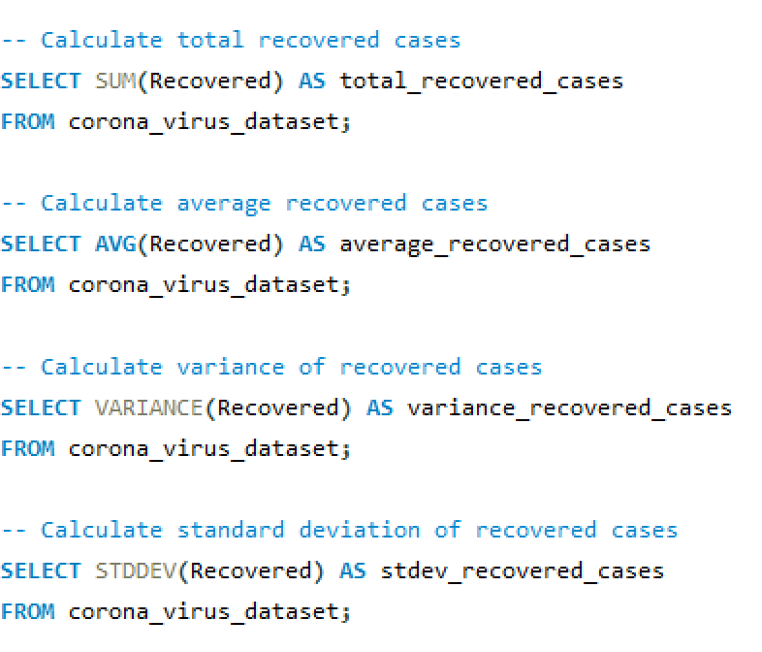
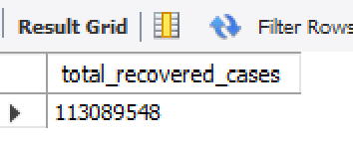
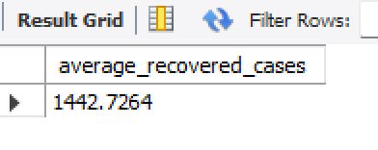
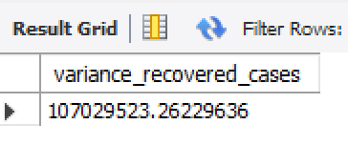
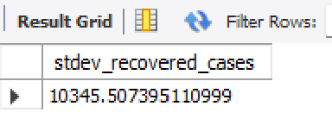
Q13.Check how corona virus spread out with respect to recovered

Slide 19
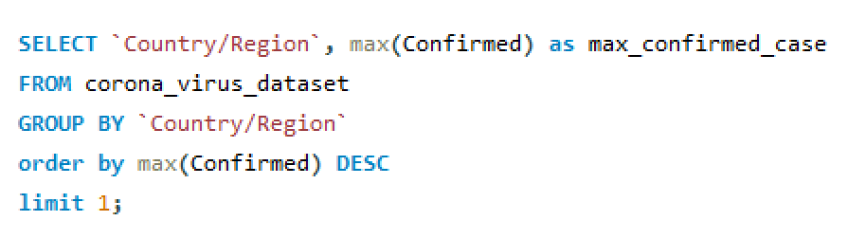
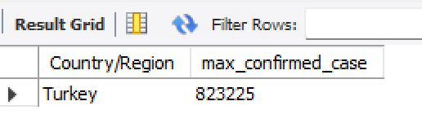
Q14. Find the Country having the highest number of Confirmed case

Slide 20
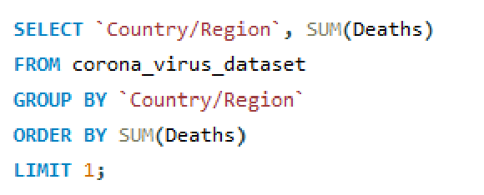
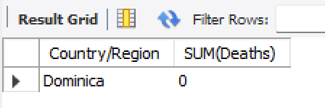
Q15. Find Country having lowest number of the death case

Slide 21
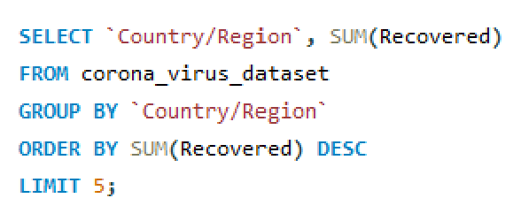
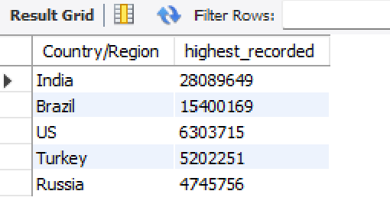
Q16. Find top 5 countries having the highest recovered case

Slide 22
﻿THANK YOU

